Slide 1
Introduction to dance Movement therapy

Slide 2
Objectives: During Workshop One, you will be introduced to the following concepts and core Dance Movement Therapy practices and how they might apply to the clinical setting:
1. Chacian Circle
2. A brief history of DMT
3. Laban Movement Analysis Efforts
4. Use of kinesphere/dynasphere
5. Use of mirroring
6. Attunement
7. Kinesthetic Empathy

Slide 3
Objectives: During Workshop Two, you will be introduced to the following concepts and core Dance Movement Therapy practices and how they might apply to the clinical setting:
1. Formed and Self-Directed Movement
2. Authentic Movement
3. A brief description of the settings/populations where DMT is used incorporating an example of a population.
4. Time will also be allocated for information and questions about the forthcoming course in Dance Movement Therapy.

Slide 4
What is Dance Movement Therapy
Dance/movement therapy (DMT) is defined by the American Dance Therapy Association (ADTA) as the psychotherapeutic use of movement to promote emotional, social, cognitive, and physical integration of the individual, for the purpose of improving health and well-being.
Moving toward wholeness

Slide 5
The evolution of Dance Movement Therapy
Ancient Cultural/Healing Dances
Dance evolved from natural human movement
Dance was used to depict Nature
1940’s onwards
Pioneers of DMT
Marion Chace
Blanche Evans
Liljian Espenak
Mary Starks Woodhouse
Trudi Schoop
Alma Hawkins
And Psychotherapy
DMT Today
ADTA
Marcia Leventhal
Johanna Exiner
IDTIA
DTAA
And for Religious/Ritualistic/Healing purposes.

Slide 6
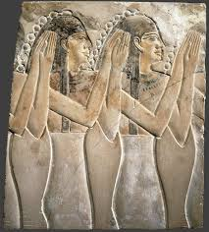
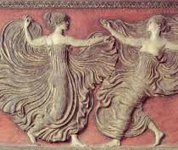
Dance: One of the oldest arts
Throughout the ages, dance, music and poetry have been inseparable.
‘Dancing is the poetry of motion, and its connection with music, as the poetry of sound, occurs at all times.’ http://www.bencourtney.com/ebooks/dance/
Dance has always had aesthetic and symbolic value.
It has helped people express their sensori-emotional experience of life.
It has helped to give meaning to natural phenomena and life experiences.
To connect and communicate with each other
The aesthetic nature of dance is keystone to Dance Movement Therapy.

Slide 7
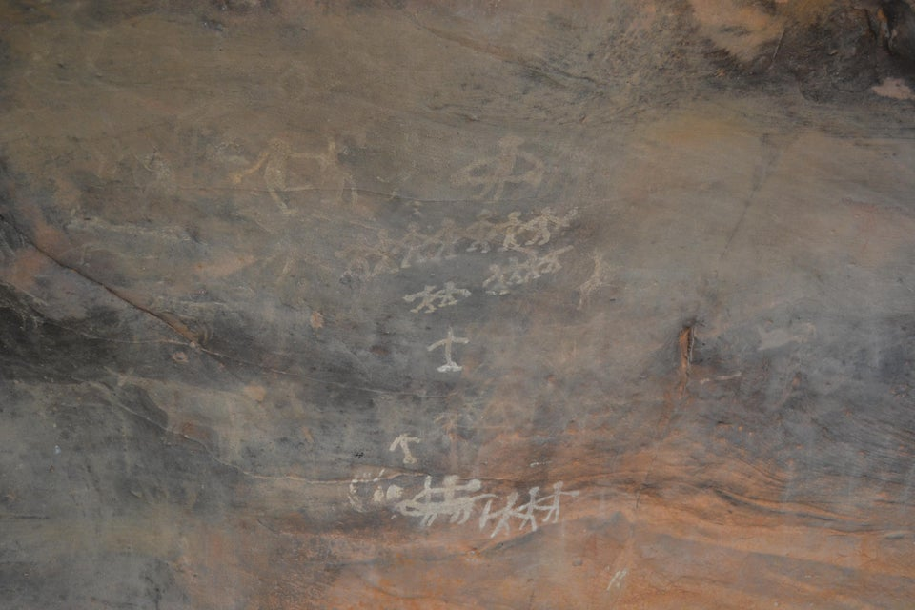
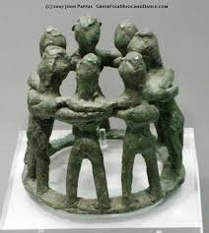
Dance One of the oldest arts
Oldest rock art depictions from India: 9000BC
Dance evolved from natural human movement: Movement of limbs, trunk, head, gestures, facial expressions
This evolved into:
acrobatic movements (Greece: 330-340 BC)
sensual movement
movement to clapping and instruments
holding hands to dance and circle dances.
costumes and paints

Slide 8
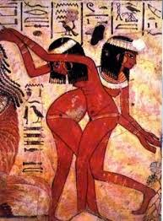
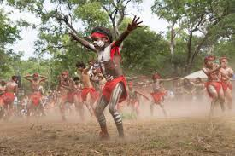
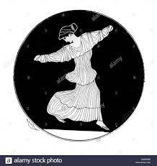
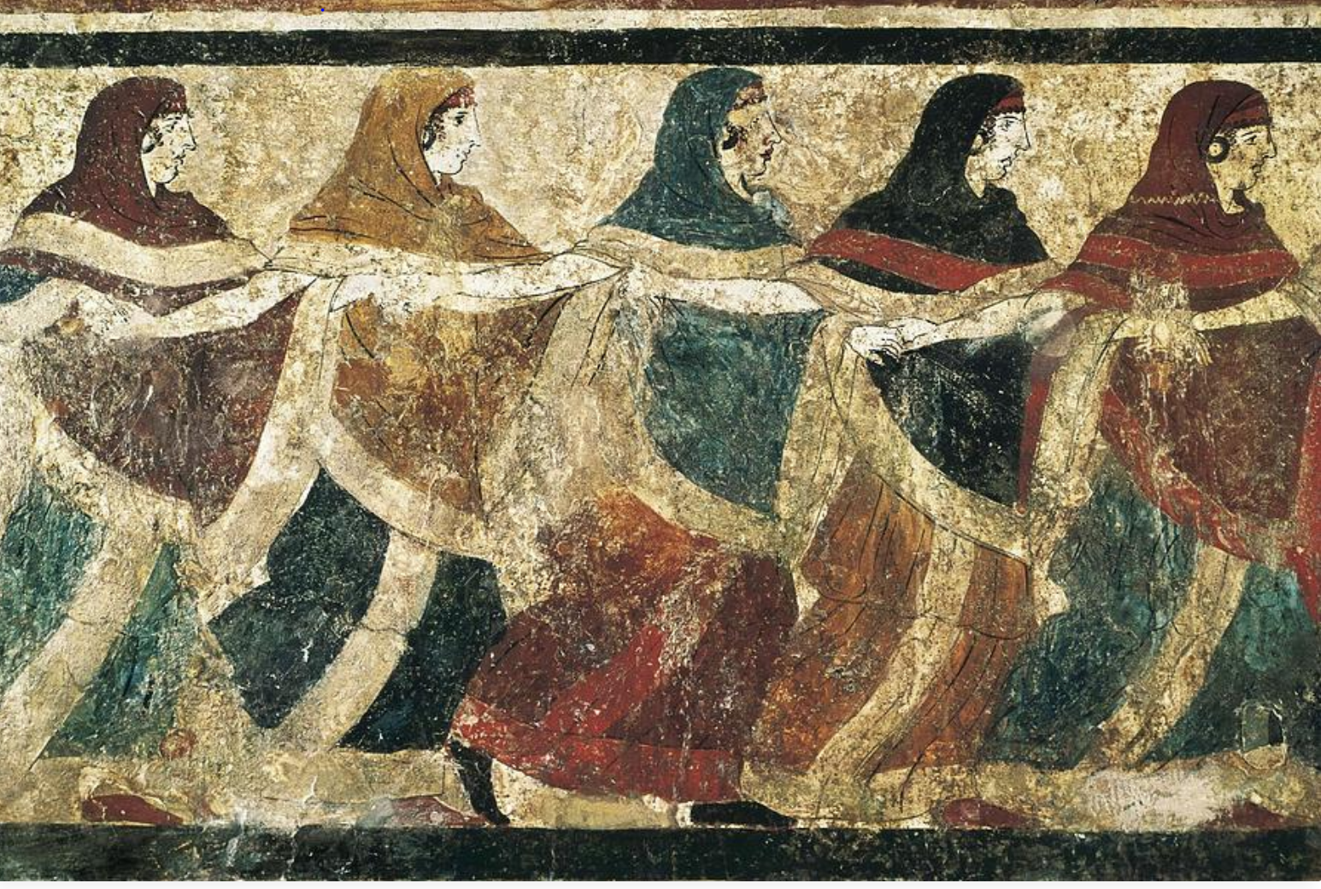
Ancient Dance

Slide 9
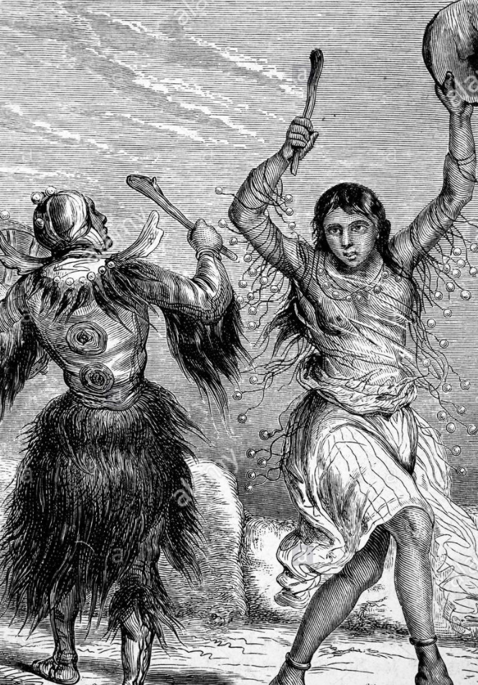
Dance: a Healing Art
‘The dance of medicine man, priest or shaman belongs to the oldest form of medicine and psychotherapy in which the common exaltation and release of tensions was able to change man’s physical and mental suffering into a new option on health. We may say that at the dawn of civilization dancing, religion, music and medicine were inseparable.’ Meerloo in Levy 1988

Slide 10
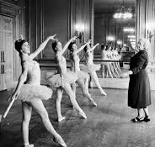
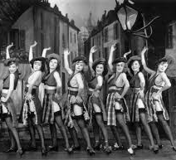
Prevalent forms of dance in the early 20th Century and the emergence of Dance Movement Therapy
Ballet Show dance
Neither form connected the person to the dance. The focus was on technique, performance and appearance.

Slide 11
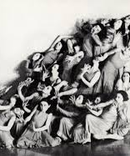
Pioneers of DMT
By the 1940’s there was a strong movement toward expressive dance. To connect dance to ‘spontaneity, authenticity and individual expression, awareness of body, themes that stressed a whole range of feelings and relationships….the essence of dance therapy.’ Bartenieff in Levy 1988
The bridge toward expressive dance were:
ancient Greek theatre which helped audiences experience emotional catharsis
and
primitive ritual dances as expressions of magic, religion and spirituality.
Mary Wigman –Germany (1886-1973) Movement Choirs
Dances that were focused on the pure essence of personal expression.

Slide 12
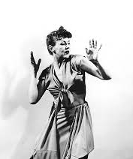
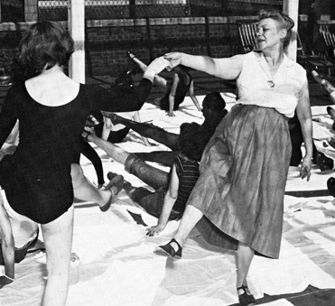
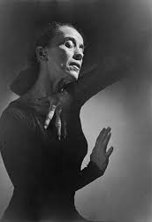
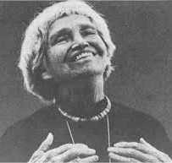
The Pioneers
Dancers in Europe and the USA, such as Mary Whitehouse, Franziska Boas, Liljian Espenak, Trudi Schoop, Marion Chace and Irmgard Bartenieff were highly influenced by Wigman and started to focus on the expressive aspect of dance to contact one’s ‘inner dance’ and the uncovering of the unconscious through body movement.
Notes:
Espenak: Developed a complete psychomotor therapy treatment plan that included Diagnostic Movement Tests and she ran the first dmt post graduate training program in the States.
Blanche Evans worked with normal neurotics to help them reunite body and mind to natural expressive body rhythms, she used a lot of improvisation
Schoop’s: well-known mime artist across Europe before moving to the States: major contribution was the exploration of playful, expressive and creative interactions with her patients.

Slide 13
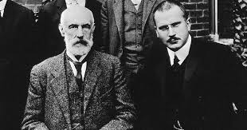
Psychological influences:
The early pioneers merged the theoretical frameworks of Freud, Adler, Jung, Reich and other psychoanalysts to their dance experience and intuitive knowledge to explore:
the motivation behind human action in their choreography
And
movement as a vehicle for self-expression
In the 1940’s dance therapy was limited to mental institutions to predominantly non-verbal patients.
By the 1950’s it had spread to private studios with ‘normal and neurotic’ individuals.
By the 1960’s trainings in dance therapy had commenced in the USA and in 1966 ADTA was formed. It was the first step toward becoming a recognized and organized profession.

Slide 14
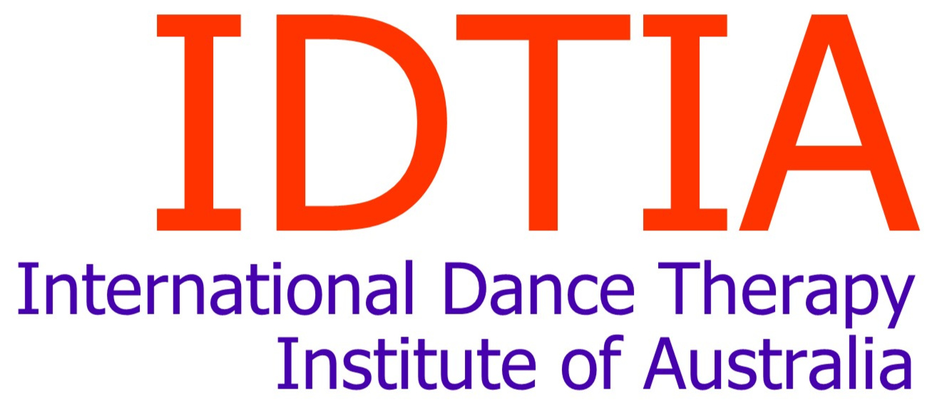
The International Dance Therapy Institute of Australia Inc (IDTIA) was established in Melbourne in 1989 out of a need for extended study and training in dance therapy.
Dr. Marcia Leventhal, who studied with early dance movement therapy pioneers and conducted the Graduate Dance Therapy Program at New York University for sixteen years, directed the initial IDTIA training programs.
DTAA was formed in 1994 to recognize DMT as a profession in Australia and now, Australasia.

Slide 15
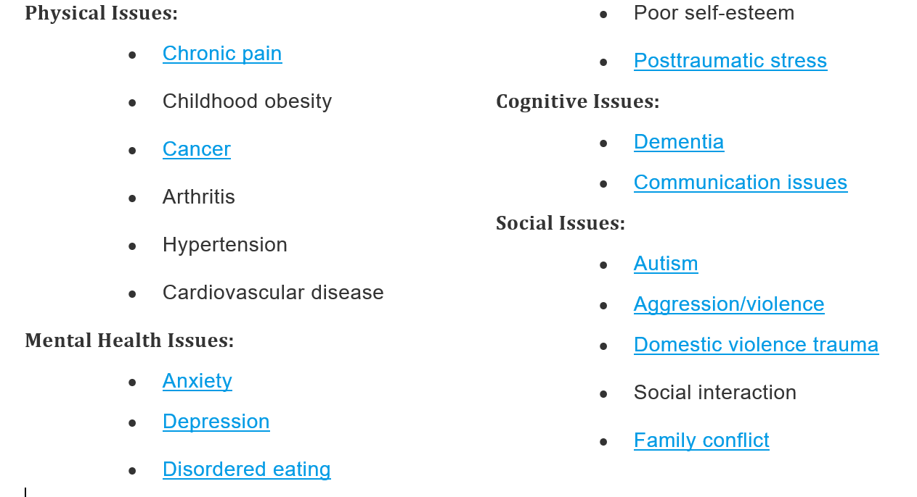
Dance Movement Therapy Today
DMT is offered in clinical, educational and community settings.
Research in the field of DMT is helping to establish DMT as primary therapy.
Dance/movement therapy is a versatile form of therapy founded on the idea that motion and emotion are interconnected. The creative expression of dance therapy can bolster communication skills and inspire dynamic relationships. It is commonly used to treat physical, psychological, cognitive, and social issues such as:

Slide 16
Dance Movement Therapy in Australia today
clinical, institutional, community and private settings
Such as:
Aged Care Facilities
NDIS Clients- in their homes, in schools, in institutions
Hospitals: Psychiatric wards, children’s wards,
Schools
Trauma Recovery
Eating Disorders
War Veterans
Private Practice
Notes:
Elizabeth Loughlin, Jane Refshauge, Kim Dunphy, Fran Ostroburski Anna Schlusser

